Slide 1
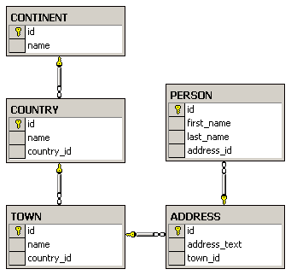
Exercises
Create the following database diagram in SQL Server:
Fill some sample data in the tables with SQL Server Management Studio.

Slide 2
Exercises (2)
Typical universities have: faculties, departments, professors, students, courses, etc. Faculties have name and could have several departments. Each department has name, professors and courses. Each professor has name, a set of titles (Ph. D, academician, senior assistant, etc.) and a set of courses. Each course consists of several students. Each student belongs to some faculty and to several of the courses. Your task is to create a data model (E/R diagram) for the typical university in SQL Server using SQL Server Management Studio (SSMS).
Create the same data model in MySQL.

Slide 3
Exercises (3)
We should design a multilingual dictionary. We have a set of words in the dictionary.
Each word can be in some language and can have synonyms and explanations in the same language and translation words and explanations in several other languages.
The synonyms and translation words are sets of words from the dictionary. The explanations are textual descriptions.
Design a database schema (a set of tables and relationships) to store the dictionary.

Slide 4
Exercises (4)
Add support in the previous database for storing antonym pairs.
Add support for storing part-of-speech information (e.g. verb, noun, adjective, …).
Add support for storing hypernym / hyponym chains (e.g. tree → oak, pine, walnut-tree, …).

